Slide 1
Gun Trusts
Future Technology & Liability Issues within the Legal Profession – Legal Career Association, LLC
Mary A. Akkerman
Davenport, Evans, Hurwitz & Smith, LLP
206 W. 14th St.
PO Box 1030
Sioux Falls, SD 57101-1030
makkerman@dehs.com
605-357-1220
www.dehs.com

Slide 2
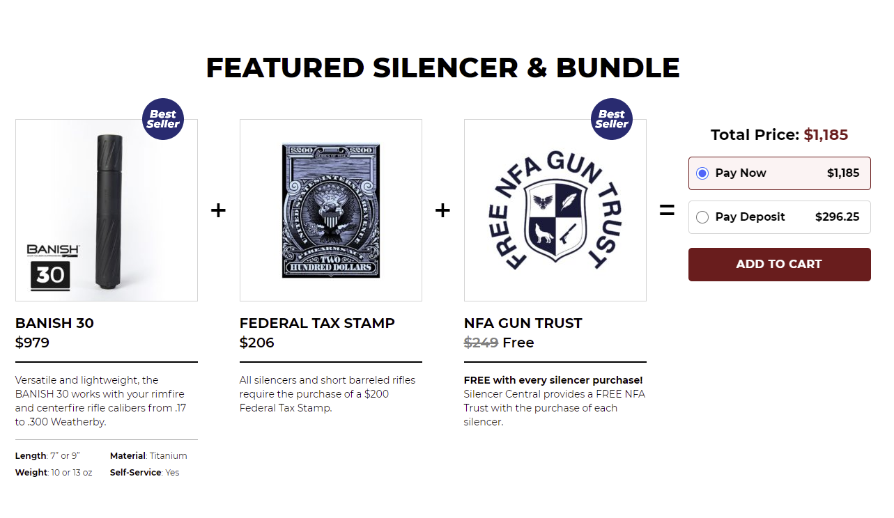
Gun Trusts: Hype, Hysteria and History

Slide 3

“Say hello to my little friend!” – Scarface (1983)

Slide 4

“Broke into the wrong [expletive] rec room, didn’t you?” – Tremors (1990)

Slide 5
Hype and Hysteria
https://forum.pafoa.org/showthread.php?t=296630
  Gun trust lawyers are present on various gun aficionado sites, along with laypeople who use taglines such as
    LOVE - It's what makes AR15s SO DARNED SNUGGLY! :)
    AMERICAN by birth INFIDEL by choice
  There is a lot of misinformation circulating among the gun owner websites, along with requests to share trust forms which typically meet with a response such as
    “Not going to give you for free what I paid a lawyer for. I survived a very serious felony stop (you can't begin to imagine) and went home with all my guns and had dinner. Did the work from the lawyer help? No way to know.”
      Unfortunately this member posted no pictures of his experience!

Slide 6

Welcome to South Dakota

Slide 7

My Law School Mascot

Slide 8

Welcome to South Dakota, Part II

Slide 9
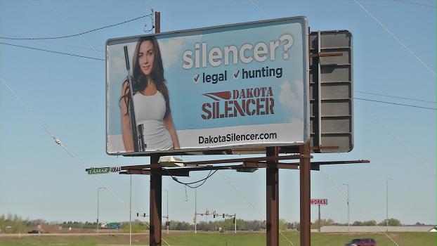

Slide 10
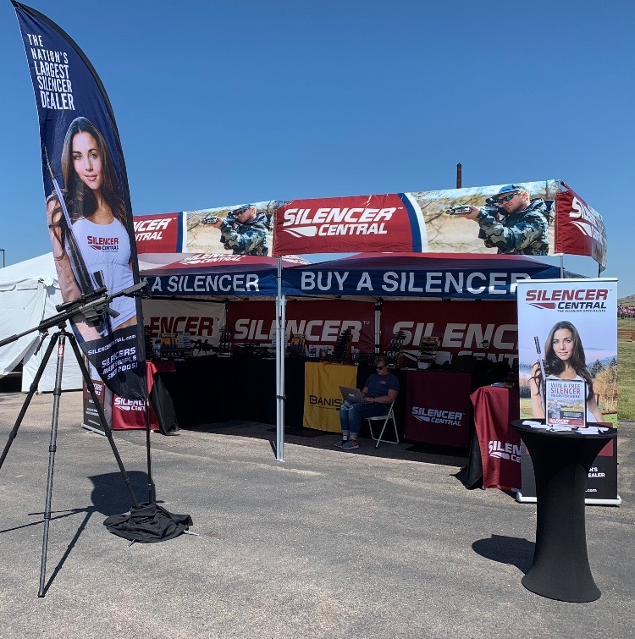

Slide 11


Slide 12
Attorney Advertising
Before we discuss some colorful ads, remember that each state has its own rules and regulations on attorney advertising
  https://www.floridabar.org/ethics/etad/
  https://www-media.floridabar.org/uploads/2020/08/Handbook-2020-8-19-20-ADA-Compliant.pdf
  https://sdlegislature.gov/Statutes/Codified_Laws/2044876
    RPC 7.1 through 7.5

Slide 13
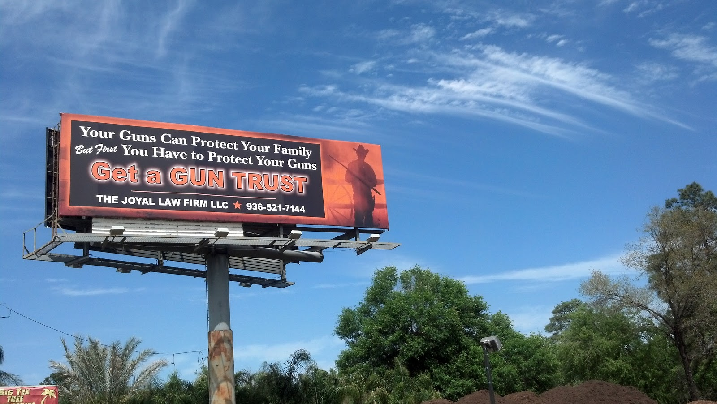

Slide 14


Slide 15
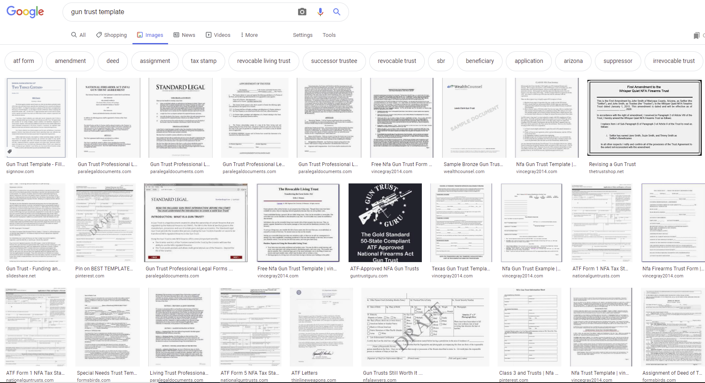

Slide 16
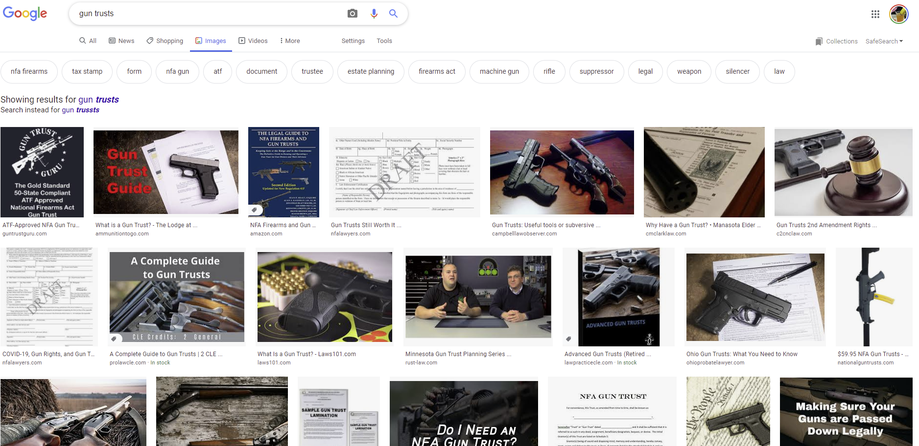

Slide 17
More Creative Marketing
https://cmclarklaw.com/want-prison-time-make-an-nfa-firearm-without-atf-approval/
  “Someone will ALWAYS turn you over to the authorities if they know you’re breaking the law and they can use this ammo against you for their convenience or benefit. Was it a jilted girlfriend? A friend who didn’t share his views about guns or the law? Who knows.” (emphasis in original)
https://commonlawyer.com/?page=Books_APT
  “…the Gun Trust is used to combat the evil empire's most-recent attack against your Second-Amendment-protected, common-law right (old Anglo-Saxon for duty) to keep and bear firearms, that is, confiscation of firearms upon the owner's death, claiming the firearms may fall into the hands of dangerous family members. But with a properly drafted Gun Trust, such firearms can pass to a successor trustee without government seizing them.” (emphasis in original)
https://www.guntrustlawyer.com/
  A separate website from the lawyer’s general law practice at https://www.jacksonvillelawyer.pro/
    Why?

Slide 18
Background
Also known as “NFA Trusts” or “NFA Firearms Trusts, after the National Firearms Act
Certain types of firearms must be registered with the Bureau of Alcohol, Tobacco, Firearms and Explosives (ATF)
  www.atf.gov
    “ATF is a law enforcement agency in the United States’ Department of Justice that protects our communities from violent criminals, criminal organizations, the illegal use and trafficking of firearms, the illegal use and storage of explosives, acts of arson and bombings, acts of terrorism, and the illegal diversion of alcohol and tobacco products. We partner with communities, industries, law enforcement, and public safety agencies to safeguard the public we serve through information sharing, training, research, and use of technology.”

Slide 19
Background
Types of firearms that are implicated by federal law
  Fully automatic firearms
  Certain short barrel rifles (less than 16”)
  Sawed-off shotguns (barrels less than 18”)
  Suppressors or silencers
  Other novelty items, such as pistol swords and walking cane guns
  “Destructive devices”
    Grenades, etc.
  “Any other weapon or device that can be concealed on the person from which a shot can be discharged through the energy of an explosive”
Does not include collectable antique weapons other than machine guns or destructive devices
  28 USC Sec. 5845(a)

Slide 20
Registration, Licensing, and Possession
NFA firearms must be registered with the ATF
  Transfer taxes must be paid to buy and/or sell them or to transfer ownership
  This is not the same as a license or permit
Possession is regulated by federal law and, in some cases, by individual states
  Each state varies as to its approach
Certain people are prohibited from possession
  Minor children and/or “prohibited persons” under state or federal law

Slide 21
Governing Law
Overview of Applicable Federal Firearms Laws
  The National Firearms Act
  The Gun Control Act of 1968

Slide 22
The National Firearms Act
Internal Revenue Code Chapter 53
  Yes, this is part of the tax code
This Act imposes a tax on the making and transfer of NFA firearms
It requires registration with the Secretary of the Treasury
27 CFR 479.90a governs the handling of firearms in probate estates

Slide 23
The Gun Control Act of 1968
18 USC Secs. 921-931
This Act regulates the interstate transportation of firearms including:
  Any weapon (including a starter gun) which will or is designed to or may readily be converted to expel a projectile by the action of an explosive; the frame or receiver of any such weapon; any firearm muffler or firearm silencer; or any destructive device.
  Antique collectable firearms are not included in this definition

Slide 24
The Gun Control Act (GCA), codified at 18 U.S.C. § 922(g), makes it unlawful for certain categories of persons to ship, transport, receive, or possess firearms or ammunition, to include any person:
convicted in any court of a crime punishable by imprisonment for a term exceeding one year;
who is a fugitive from justice;
who is an unlawful user of or addicted to any controlled substance (as defined in section 102 of the Controlled Substances Act, codified at 21 U.S.C. § 802);
who has been adjudicated as a mental defective or has been committed to any mental institution;
who is an illegal alien;
who has been discharged from the Armed Forces under dishonorable conditions;
who has renounced his or her United States citizenship;
who is subject to a court order restraining the person from harassing, stalking, or threatening an intimate partner or child of the intimate partner; or
who has been convicted of a misdemeanor crime of domestic violence.
The GCA at 18 U.S.C. § 922(n) also makes it unlawful for any person under indictment for a crime punishable by imprisonment for a term exceeding one year to ship, transport, or receive firearms or ammunition.
Further, the GCA at 18 U.S.C. § 922(d) makes it unlawful to sell or otherwise dispose of firearms or ammunition to any person who is prohibited from shipping, transporting, receiving, or possessing firearms or ammunition.
Source: https://www.atf.gov/firearms/identify-prohibited-persons (emphasis in original)

Slide 25
How Does a Gun Trust Protect Guns?
Spoiler alert: it doesn’t necessarily, unless the guns might otherwise be in the possession of a prohibited person and subject to possible seizure
But it does protect the owner
  How?
    Gun trusts protect owners and their friends and family from unlawful possession of a regulated firearm
      Illegal possession is typically a felony under federal law
      Illegal possession can, in some instances, result in confiscation of the offending firearm, so in that way a Gun Trust can provide some protection for the guns themselves
    But these devices are primarily designed to protect against illegal possession
  It also can allow transfer of NFA firearms to the beneficiaries at the death of the settlor without the estate representatives having to worry about whether they are entitled to possession during estate administration
    So, perhaps to that extent, it protects the guns
    But mostly it protects those parties handling the guns

Slide 26
Historical Treatment of Gun Trusts
Prior to July 13, 2016, ATF regulations required a Chief Law Enforcement Officer to sign off on purchase of NFA firearms
  Gun Trusts were used to bypass these requirements and streamline purchase of NFA firearms
Current law no longer requires the law enforcement sign off, making it easier for individuals to purchase NFA firearms

Slide 27
Historical Law
Also, prior to July 13, 2016, a loophole existed that allowed individuals acting on behalf of a trust to purchase an NFA firearm without a background check or ID.
  This law changed to require background checks for “Responsible Persons” (e.g. trustees) pursuant to 27 CFR Part 479, known as ATF Rule 41
  Responsible person is “any trust, partnership, association, company (including LLCs), corporation or individual who possesses directly or indirectly the right, power, or authority to direct the management and policies of the trust or entity to receive, possess, transport, ship, deliver or dispose of a firearm on behalf of or for the entity.

Slide 28
So, Are Gun Trusts Still Useful?
Under current law, an individual can transfer an NFA firearm by completing the ATF application, submitting a copy by mail to the appropriate Chief Law Enforcement Officer, then submitting the application, fingerprints, and a passport photo
  This sounds easier than what a Gun Trust trustee must do, below
A trustee of a Gun Trust must complete the ATF application, and also must have the Co-Trustees (Responsible Person in ATF lingo) associated with the trust complete a new ATF form. The trustee must submit a copy of all the ATF forms by mail to law enforcement, and then submit a copy of the entire gun trust, the ATF application and forms, and fingerprint cards and passport photos for every Responsible Person to the ATF
  This is more work than buying as an individual purchaser

Slide 29
So, Why Do a Gun Trust?
It allows family or friends to possess without the owner’s presence if properly drafted
It can prevent illegal constructive possession if the firearm is potentially accessible by others in the household
It can prevent problems if a spouse needs to use the gun while the owner is absent
As with any trust, it can prevent the need for a POA or conservator if the owner becomes incapacitated

Slide 30
More Reasons
Prevents the need for POA to handle NFA firearms
Avoids the need for NFA firearms to go through probate
  Avoids succession by intestacy if no will or will doesn’t properly dispose of firearms
  Avoids cost and need for probate of firearms
    Best if all property is titled to avoid probate, not just firearms
    Accordingly, NFA Trusts work best with a comprehensive estate plan, although they are best structured as stand alone trusts
Avoids publicity of probate
  Probate is public record
  Inventories may be made public, listing firearms

Slide 31
What Gun Trusts Cannot Do
Allow ownership or possession of firearms by “Prohibited Persons”
Save you or your clients from the “evil empire”(i.e., changes in state or federal law)
  That is, changing laws may affect Gun Trusts
Address ownership or possession of non-firearm property at a client’s incapacity or death
  They are not a complete estate plan or substitute for baseline, basic planning
  They are best used to complement or add on to basic planning vehicles
  Clients who want a Gun Trust should be strongly encouraged to have their entire estate plan addressed at that time
    Most lawyers who do Gun Trusts also do regular estate planning and probate

Slide 32
More Things Gun Trusts Cannot Do
Protect from liability from misuse of the firearm
  Some websites claim that Gun Trusts may be structured as “asset protection trusts”
    https://www.ammoland.com/2012/04/a-new-breed-of-gun-trusts-protecting-firearms-collectors-their-collections/#axzz6o9VL9lCV
  They mean that assets in trusts would not be subject to future creditor claims, potentially
  This is not the same thing absolving the owner/trustee from liability if firearms are used irresponsibly or negligently

Slide 33
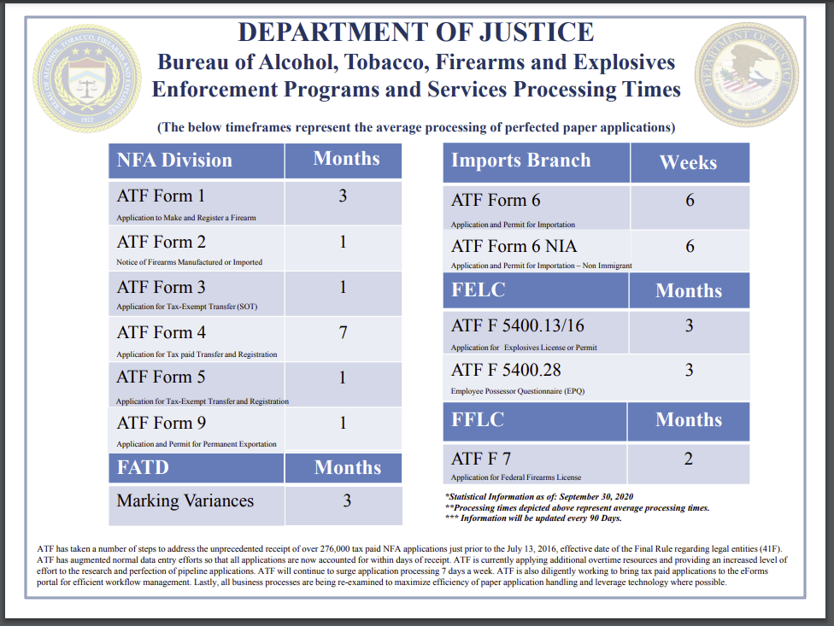
Timelines

Slide 34
Purpose of Gun Trusts
Why Would a Client Need a Gun Trust?
  Local, State and Federal Laws
    Every jurisdiction has its own local and state firearms laws
    Gun Trusts are designed to work with federal regulations, generally, but should also be constructed with state and local laws and regulations in mind
    Many of the national Gun Trust preparers will seek local review by counsel in the client’s home jurisdiction for this reason
  Ownership Succession

Slide 35
Drafting Tips
Preparing the Gun Trust
  Forms
    From a List Serve email: “[Gun Trusts] are definitely not an adaptation of any type of estate planning trusts. They are kind of sui generis. They should be used only for firearms [both NFA and ‘garden variety guns (sic)] and not for other purposes….Regarding ‘Legal Zoom,’ ‘Will Maker,’ etc. some people have used them, and have had them rejected by BATF. Unfortunately, I can’t provide people with a form for two reasons. First, the properly done NFA trusts that I’ve seen, including ours, are copyrighted items. Second, someone using a form who doesn’t know about the NFA ant other firearm laws can, in good faith, change the document and inadvertently cause litigation which could be detrimental to others.”
      This is from a private group, so I won’t identify the lawyer, but this particular individual did reference in the email a link to that particular lawyers specialized “Gun Trust Lawyer” website which was a different site that this lawyer’s regular law firm website.
    From an article by attorney Michael Sneeringer: “The contents of a gun trust are no different than any other revocable trust, except for references and terms related to firearms and the [Gun Control] Act.” Gun Trusts – What’s All the Fuss? www.americanbar.org/groups/real_property_trust_estate/publications (April 2017)
      So, Gun Trusts are either “definitely not an adaptation of any type of estate planning trusts” or “no different than any other revocable trust, except for references and terms related to firearms and the Act” – or are they something in between?
  So, where can you get a good form?
    Some subscription services include them
    There are dozens that show up on a Google search
    Or create your own

Slide 36
Checklist
From Michael Sneeringer ABA Article:
  Will trust be revocable or irrevocable?
    Most are revocable
      If possessory rights are the priority
    Asset protection or estate tax planning may require irrevocable transfer
      If tax planning or protection of trust property from future creditors is a priority
  Who will serve as trustee?
    If selecting a jurisdiction other than client’s home state, may require trustee in desired jurisdiction which can complicate tax planning, situs, and possessory rights

Slide 37
Checklist, page 2
Compliance with the Gun Control Act
  Does the trust contain specific verbiage, and does it actually comply?
Compliance with the National Firearms Act
  Again, the trust should contain appropriate language and must actually comply
Compliance with all local, state, and federal firearms laws
  The trust must have a statement of compliance, actually be in compliance, and must be administered in compliance, including termination when and if the trust ends

Slide 38
Checklist, page 3
Information on trustee, successor trustees, and beneficiaries must be obtained, and all of these parties must be screened to prevent naming of prohibited persons
  Name and all names used, date of birth, Social Security Number, address, phone, and criminal records search
    May also wish to do a credit search or general background search
    Keep in mind there are legal limitations on what searched may be done, how they are conducted, and whether the attorney has authority to use subscription databases to conduct the search
    Should these searches be done by the attorney’s office, or can you rely on the client to do them?
    Factor in cost for searches
    Who is liable if prohibited persons are named?
    Who is responsible for ensuring that any trustee or beneficiary who later becomes a prohibited person is removed from these roles?
      Drafting tip: state that any person who later becomes a prohibited person is immediately removed as trustee or beneficiary, and include succession provisions to fill any vacancy created by this provision

Slide 39
Checklist, page 4
Consider length of trust
  Is it designed to be perpetual, if drafting in a jurisdiction that allows dynasty trust
  Can the trustee distribute firearms out of the trust to a beneficiary?
  What happens at termination?
    This is the same as any trust planning, but special considerations must be taken into account so that firearms do not pass into the possession or ownership of a prohibited person
      Drafting tip: include language prohibiting possession or ownership of firearms by any prohibited person during the term of the trust (as mentioned in the prior slide) and at termination and/or upon distribution of assets out of the trust

Slide 40
Checklist, page 5
How about directed trust provisions?
  What is a directed trust?
    Inclusion of an investment committee/advisor, distribution committee/advisor, family committee/advisor, and/or trust protector
      Does the jurisdiction allow this structure?
      Does the AFT allow this structure?
      Do these parties require the same scrutiny as trustees and beneficiaries?
Is a trust protector ok?
  Can you use one in a jurisdiction without statutory authority?
  Will the ATF accept this structure?

Slide 41
Checklist, page 6
Who or what is the ultimate contingent remainderman?
  I.e. what do you put in the “doomsday clause”?
    If it’s a class of people (i.e. descendants) none may be a prohibited person
    Charities as the ultimate contingent beneficiary
      Structure may be included to allow/require the gun collection to be sold with proceeds to charity
    Require sale of guns and proceeds held in trust, distributed to beneficiaries, decanted/distributed/appointed in further trust
  Minor children can be beneficiaries so long as they have no access to firearms until age 18, meaning the guns must continue in trust until the children are adults and may not be distributed outright to minors
Accurate inventory of assets
  Client must provide a complete list of all firearms to be transferred

Slide 42
Checklist, page 7
ATF Tax Stamp must be applied for
  Form 4 https://www.atf.gov/firearms/docs/form/form-4-application-tax-paid-transfer-and-registration-firearm-atf-form-53204/download
  $200 fee
  Must include info on transferor, transferee, items being transferred, identity of Responsible Persons, background check info, payment of fee, copy of the Gun Trust, photos, fingerprints, copy to the appropriate chief law enforcement officer, Social Security numbers, mental health information, addresses, citizenship info, etc.
    Good news! You can pay by credit card. But it’s probably best to pay the fee from trust funds, rather than using the grantor’s credit card.
  Keep the tax stamp with the weapon, keep an electronic copy easily available, and make copies of the tax stamp for all weapons if there is more than one firearm in the trust, so that each weapon has a copy with the actual weapon
ATF Form 4 goes to an ATF examiner for processing
Is the lawyer’s office going to complete the forms, or is the client?
  What do you need to keep in your file? What is the lawyer’s due diligence requirement?
This is a lot of information to disclose to the “evil empire” isn’t it?

Slide 43
Timeline
Purchase the NFA firearm or identify target purchase or existing NFA firearm to go into trust
Prepare and execute the Gun Trust
Fund the Gun Trust with purchase money
  Requires opening a bank account for the trust
  Irrevocable trusts will need an EIN
Bring the Gun Trust to the firearms dealer if purchasing new firearms to go into trust
Prepare and submit ATF Form 4
  As part of this preparation, extensive information about Responsible Parties will need to be gathered
Wait for ATF to process Form 4
AFT denies or approves Form 4 or asks for additional information and, if approved, issues a Tax Stamp
Execute appropriate paperwork to place items in trust
  Bill or sale or assignment from current owner to trust
  Update trust inventory as assets change
Trustee may pick up new item from firearms dealer and/or lawfully possess existing items that have been transferred into trust
  Firearms dealer may require additional background check at that time

Slide 44
Further Considerations
Why may possess firearms owned by a Gun Trust
  The trustee(s) and current permissible beneficiaries who are not prohibited persons
    Minor beneficiaries may be named as beneficiaries but may not possess trust assets until reaching age 18
    Contingent beneficiaries without a current right to trust assets may not possess until and unless they become primary beneficiaries
Drafting tip: drafting flexible trustee succession provisions allows for ease of ownership and use of trust firearms, as situations change and different users are desired
  Many practitioners include forms for trustee succession to assist clients in changing trustees when new or different family members or friend wish to use or possess the trust assets
  Include succession, removal and replacement, and resignation terms
  Trustees may be temporary or permanent
    Why make a trustee temporary?
      To account for temporary possession if desired
  What is the lawyer’s responsibility for ensuring that a client follows trustee succession terms in the trust successfully?
    Define scope of representation in the engagement letter

Slide 45
Further Considerations
Multiple grantors are permissible
  This structure may work well for spouses, but can be messy when used for unrelated parties or more remote family members
    Cleaner for each person to do his or her own Gun Trust if you’re working with a group of gun enthusiasts who are interested in pooling their firearms and creating one trust
Multiple trustees are permissible
  Some state laws may require someone other than the grantor to serve as co-trustee
  Some state laws might require that the trustee be a resident of the grantor’s state
State laws may restrict movement of the trust property outside the state or from state to state
  Federal law requires AFT Form 5320.20 to receive approval to transport trust assets either temporarily or permanently, and such approval must be given before transport (i.e., preapproval is required)
  https://www.atf.gov/firearms/docs/form/application-transport-interstate-or-temporarily-export-certain-nfa-firearms-atf/download
  Do you need to inform the trustee of this requirement?
  Should terms be added to the trust requiring the trustee to obtain this preapproval?
  ATF approval is limited to a period of 1 year for temporary transport
  Each location where assets will be located requires preapproval

Slide 46
Further Considerations
Should a law firm review Gun Trusts purchased by clients as part of a “buy a silencer, get a gun trust free!” deal?
  If the client is willing to engage private counsel, a second review may be helpful if the reviewing attorney is comfortable with the scope of representation
  In the ideal situation, “free” Gun Trusts provided by firearms dealers are prepared by and reviewed by attorneys as part of the process
    Is this common practice?
    How can a client tell?
    How can the reviewing attorney tell?
  Who has the liability in these cases if the trust is not properly drafted and administered?
As with any trust asset, the trustee has a duty to properly maintain trust assets
  This include proper maintenance, safekeeping, and storage of all firearms in the trust
    Secure storage and safekeeping is especially important for this type of trust asset
    Do not intermingle trust assets with the trustee’s own asset or other people’s assets
  The trustee must also ensure that the firearms are properly insured against theft or damage

Slide 47
Other Trustee Duties
Along with maintaining and insuring the firearms, the trustee must
  Faithfully administer the trust according to its terms
  Administer the trust in the interests of the beneficiaries (duty of loyalty)
  Treat the beneficiaries impartially, unless otherwise indicated by the trust terms (duty of impartiality)
  Invest the trust and administer the trust prudently
    Drafting tip: waive the prudent investor standard in the trust instrument as the trust will be concentrated in firearms as assets, rather than the typical trust asset profile of marketable securities or more traditional assets
  Keep and maintain books and records of the trust and pay any required taxes, fees, and costs of administration
  Provide information to beneficiaries are requested and/or required by law and the trust
These are not unique to Gun Trusts but still apply
The trustee is a fiduciary and has a fiduciary duty to the beneficiaries, as with any trust

Slide 48
Other Fun Facts
Most Gun Trusts are revocable and included in the grantor’s estate for federal estate taxes
  For tax purposes, these are grantor trust with any taxes paid by the grantor
They may be structured as irrevocable trusts
  For tax planning or asset protection purposes
  Obviously, these are less flexible structures
Some firearms require engravings identifying the owner
  Applies to short-barrel rifles and shotguns and silencers
  The full name of the trust must be used
    Consider length and name of trust when creating document

Slide 49
Probate and Trust Administration
Issues Surrounding Firearms in Estates
  Possession
  Transport
  Sale
  Who may inherit
  Privacy

Slide 50
Probate and Trust Administration
27 CFR Sec. 479.90a addresses the handling of firearms in a decedent’s estate
  The personal representative “may possess a firearm registered to a decedent during the term of probate without such possession being treated as a ‘transfer’” (as defined by federal law). On or before closing the estate, the personal representative “must submit an application to transfer the firearm to beneficiaries or other transferees…” If transferring to a beneficiary, ATF Form 5 is required (Application for Tax Exempt Transfer and Registration of Firearm) to register the firearm with the beneficiary.
    Can the trustee of a Gun Trust get by with this form upon transfer of trust property out of the trust to a beneficiary, or is a new Form 4 and payment of the $200 fee required?

Slide 51
Gun Trusts and Probate
A properly structured Gun Trust will keep the firearms out of probate and out of the public record
  Accordingly, the regulations governing Personal Representatives in the prior slide will not be required
It is possible that even firearms in a Gun Trust might end up in an estate if not properly administered or if the beneficiaries are not structured in a way that prevents the grantor’s estate or a beneficiary’s estate from becoming the owner of the firearms
  In other words, draft to avoid having trust property revert to the grantor or end up in a beneficiary’s estate
Keep in mind that revocable trusts can by their very nature be revoked, in which case there will be transfer issues getting the firearms back to the grantor

Slide 52
Conclusion
Firearms are heavily regulated under local, state and federal law
The client’s jurisdiction may have state or local laws that apply in addition to applicable federal gun laws
Gun Trusts remain useful in protecting possessory rights to regulated firearms and for transfer of firearms upon the owner’s death or upon termination of the trust
Gun Trusts do not take the place of baseline estate planning but can be used to complement basic planning for clients with NFA firearms or who wish to pass along guns at death
Gun law is heavily marketed as a specialty area and may include much more than gun trust preparation
  Gun Trust Lawyer is a registered trademark, for example, and as mentioned above, many Gun Trust forms are copyrighted
Get yourself a catchy website before they are all taken, like these existing gems:
  https://www.guntrustguru.com/south-dakota
  https://nfalawyers.com/
  https://www.arsenalattorneys.com/arsenal-gun-trust
  Not yet taken: boomstickslawyers.com; dontbringaknifetoagunfightlaw.com; idcatchagrenadeforyoulaw.com

