Slide 1

Asset Location & Recovery International LLC.
4700 NW 6th Ave. Deerfield Beach, FL 33064 USA
Telephone USA 954-744-6085
assetlocation@aol.com
www.assetlocationrecovery.com
Asset Location & Recovery International LLC, a Florida USA Corporation
Location of Domestic Assets
Use of databases New Technologies
Private and Overt Databases
Remedies to Recover Assets
Judgments vs default judgments Assets:
Bank accounts, Trusts, Brokerages balances, Stocks, Bonds
Wyoming - South Dakota - Delaware

Slide 2
Remedies to Recover Money
Mutual Legal Assistance Treaty
Mareva Injunction Anton Pilar Acts Civil Litigation
Hybrid attack - part criminal part civil
So called Confidential Banking Laws (KYC)
Fidelity Bond Claims
Technologies used to Locate Assets
Equipment
Corporate Espionage morphing to Hacking/Cyber Attacks Legal Issues and organizations that monitor banking cyber
Most important-How to obtain documents:
Bank statements, bank application forms, Swift/wire logs, signature cards, customer service correspondence, Facebook, Twitter, e-mail, texts.
Subpoenas in USA and Offshore Investigative tactics to Obtain Documents
What is the most secret/secure venue to secrete assets?
Divorce Financial Crimes Investment Fraud
“Locating assets anywhere in the world”

Slide 3
Locating Offshore Assets in the Following Venues
Venues
Switzerland
Vehicle to secret assets
Swiss Management Portfolio Account
Liechtenstein
Investment Fund / Bank Account
Gibraltar
Bank Account
Isle of Mann
Bank Account
Guernsey
Fairbairn Trust
Jersey
Bank Account
Panama
Fiduciary Issues
Belize
Bank Accounts
Cayman Islands
Bank Accounts
Turk & Caicos Islands
Bank Accounts
Bermuda
Insurance Trust
NOTE:
Bahamas and Hong Kong there are no longer true banking havens.
Possible new banking haven in Seborga (Italy?)

Slide 4
ProfileAll.com
Intelligence Report Financial Intelligence Report Visuals and Analysis Report

Slide 5


Intelligence Report
Today’s Date:
Current Driver’s License:
First Issued Date: Expires:
Aliases:
Passport #:
INS entries into U.S.:
Current Vehicle Registration Information:
Name:
Last First Mid
Home Address:
City State Zip
Telephone: Fax:
E-mail: Was born:
Birthdate: / /
Day Month Year
Age: Color: Height:
SS#:
Was issued in: Between:
Male Female Single Married
Divorced Widowed Separated
Driving Record in Country of Origin:
Driving Records:
Education:
University Major & Records:
Who has telephoned this person:
Who has paid this person in three months period:
Wire Transfers: Account Numbers:
Balance:

Slide 6
Intelligence Report
Other Records / Names Linked to SS#:
Marriages:
Possible Credit Card Activity:
Addresses Linked to Subject:
Possible Property Ownership:
Possible Property Ownership:
Possible Relatives:
Fictitious Names Ownership:
Possible Investments:
Possible UCC Lien Filings:
Possible Professional Licenses:
Possible Corporate Links:
Possible Employers:
Neighbor Listing of Subject Addresses for Area Canvas:
Telephone Listings for Subject Address:
Possible Criminal History:

Slide 7

Financial Intelligence Report
Bank
Checking Account #:
Checking Account Balance: Savings Account #: Savings Account Balance:
Stock Account
Name: Number: Balance:
Investment Account
Name:
Number: Balance:
Overseas Account
Trust Management Portfolio Savings Name: Number: Balance:
Address:
Phone:
Corporate Account
Name:
Number:
Balance:
Address:
Phone: Money Market Account
Name:
Number: Balance:
Address:
Phone:
International Account
Fiduciary Law Firm Treuhand Name: Number: Balance:
Address:
Phone:

Slide 8

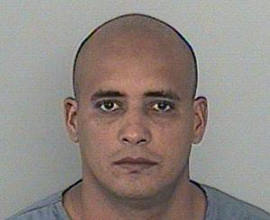
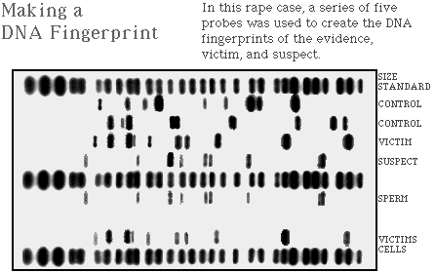
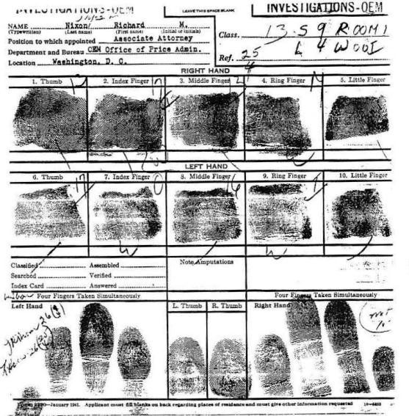
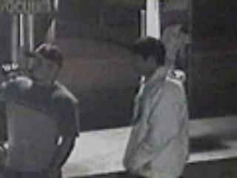
Visuals and Analysis Report
Photographs:
DNA:
Fingerprints:
Real Time Visual:
Analysis:

